Slide 1
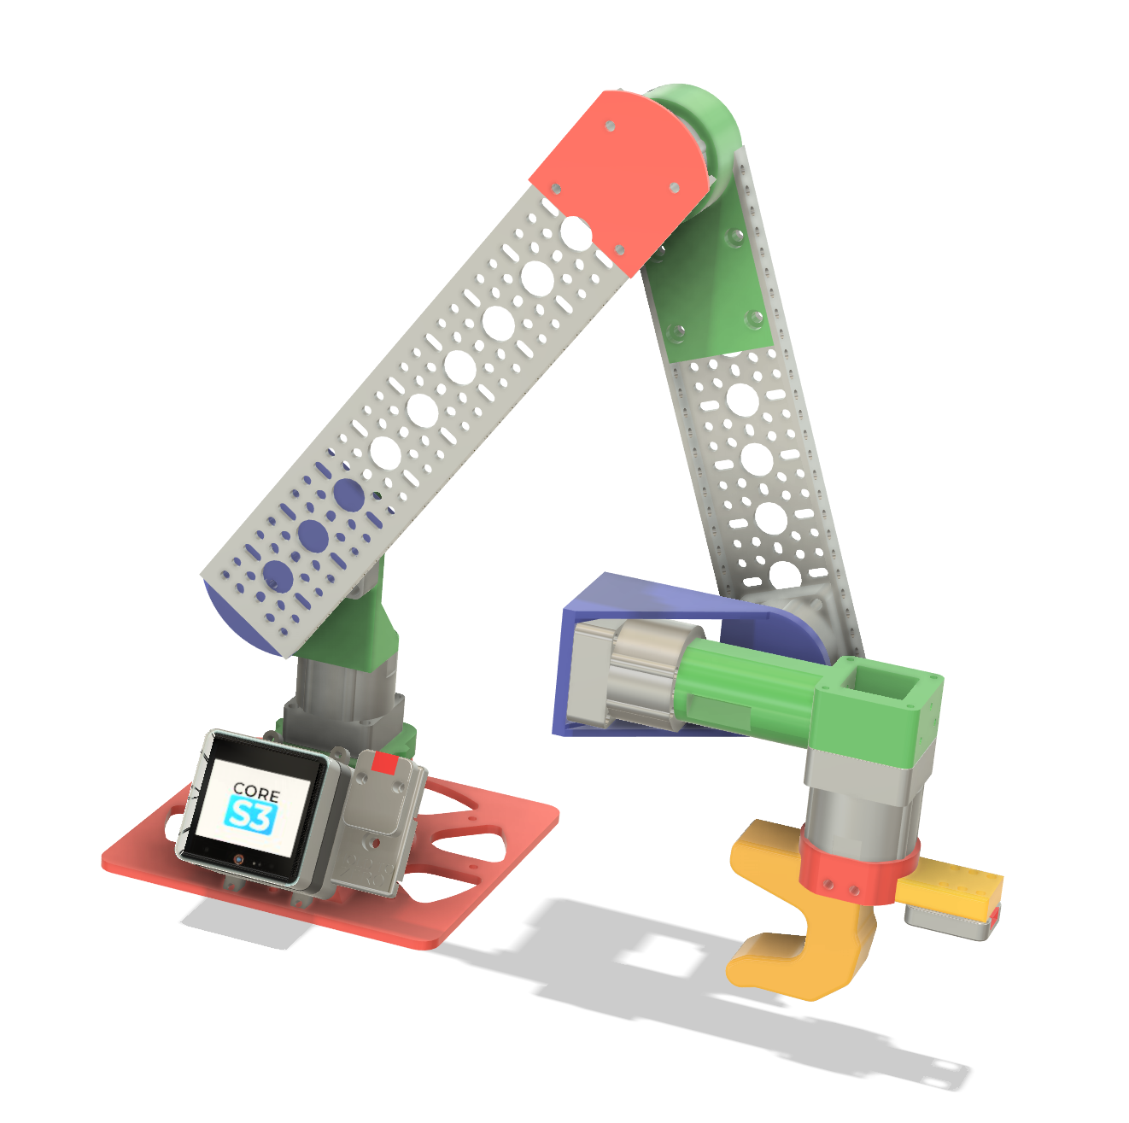
264mm/10 hole
Gobuilda
1121-0010-0264
216mm/8 hole
Gobuilda
1121-0008-0216
DIN RAIL

Slide 2
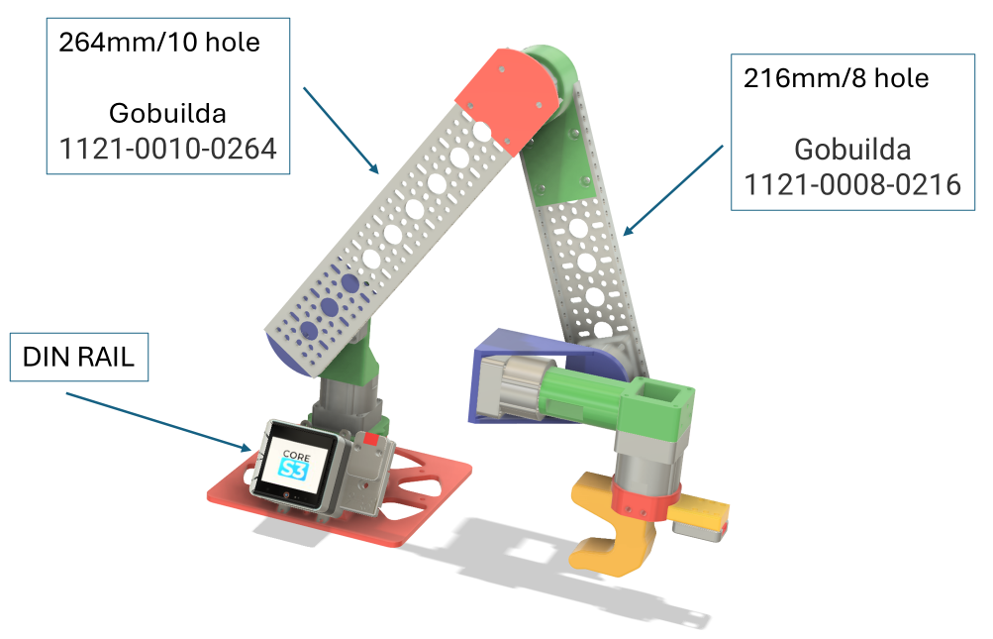

Slide 3
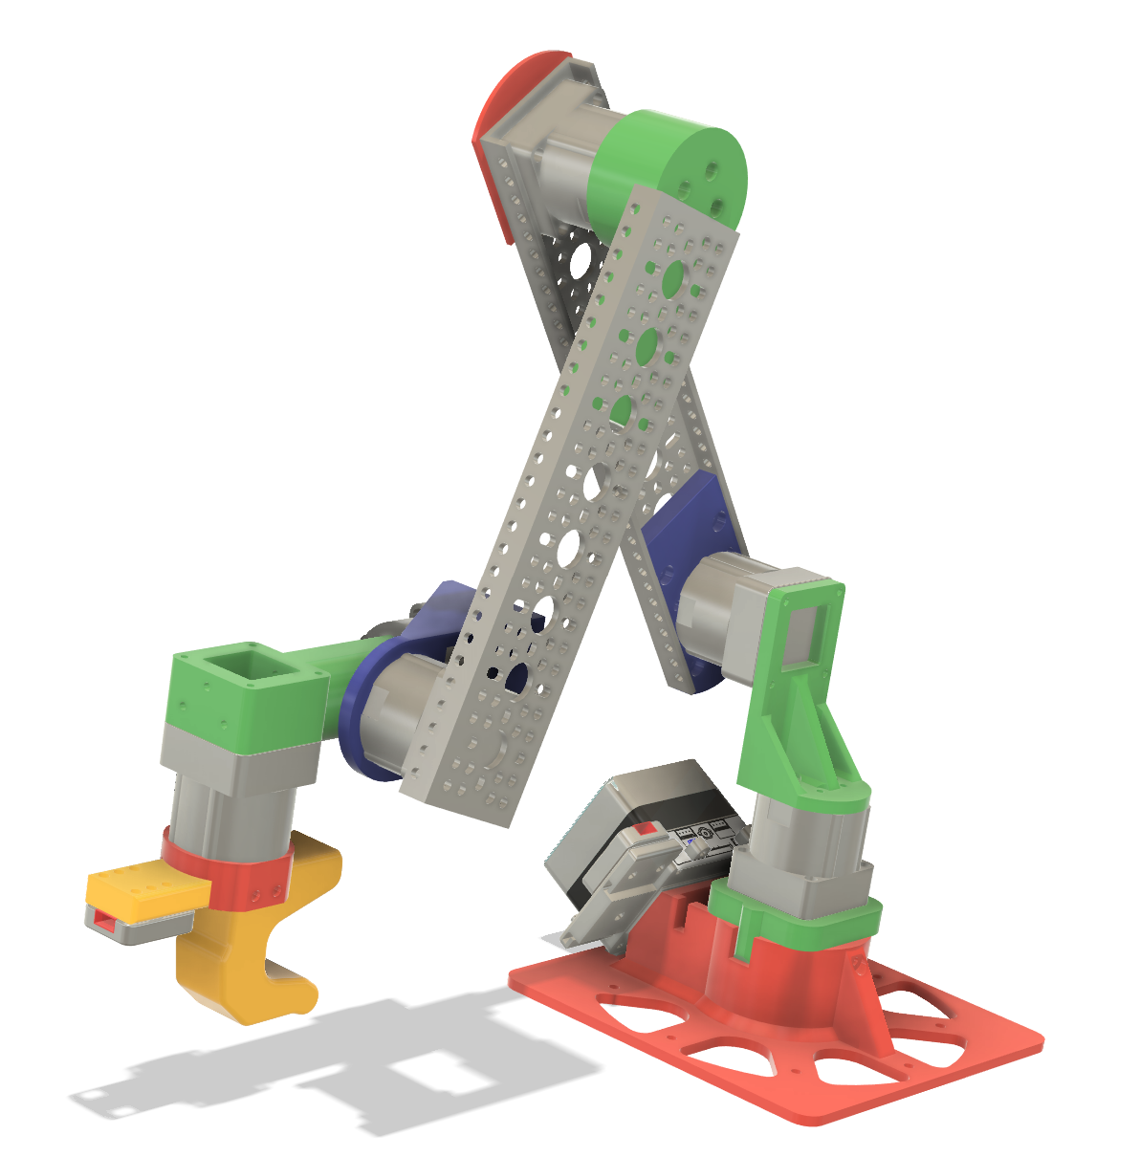
Link_3.stl
Link_3.stl
264mm/10 hole
Gobuilda
1121-0010-0264
216mm/8 hole
Gobuilda
1121-0008-0216
Link_4.stl
Link_2.stl
Link_1.stl
Link_7.stl
/Common Parts/Base/*
Common Parts/M5_compatible_handle/*

Slide 4
